Slide 1
Project Pitch: Beyond Buttons: Rethinking Control
Presented by Alex Wood
Games Development Project
Notes:
This is an opportunity to start developing ideas for your Final Year Project, helping you feel confident, excited, and prepared for the start of the module! Create a presentation, such as a PowerPoint, to share with your project supervisor. In this presentation, include key influences from similar projects, a relevant job listing (it doesn't have to be a junior role), and any work you have done on your project so far. Remember, this idea does not have to be your final proposal—projects evolve and mature. Starting to outline your ideas now can be motivating and relieve some of the pressure, especially if you feel overwhelmed by choices or simply want to explore an idea. It will also help you determine if your project is appropriate and manageable

Slide 2
Project Pitch: Beyond Buttons: Rethinking Control
Main Deliverable:
The goal of this project is to create a series of technical demos showcasing different input and output methods;
The Reason:
Testing their feasibility in game development with the possibility of expanding the ways a player can interact with the game and hopefully how the game interacts with the player.
Notes:
This is an opportunity to start developing ideas for your Final Year Project, helping you feel confident, excited, and prepared for the start of the module! Create a presentation, such as a PowerPoint, to share with your project supervisor. In this presentation, include key influences from similar projects, a relevant job listing (it doesn't have to be a junior role), and any work you have done on your project so far. Remember, this idea does not have to be your final proposal—projects evolve and mature. Starting to outline your ideas now can be motivating and relieve some of the pressure, especially if you feel overwhelmed by choices or simply want to explore an idea. It will also help you determine if your project is appropriate and manageable

Slide 3
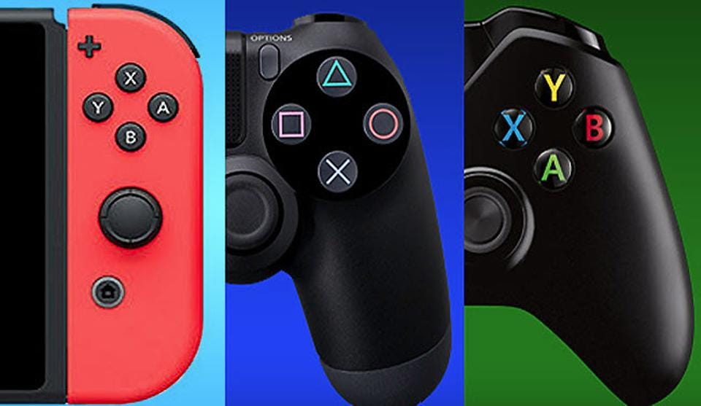

The Problem with Current Control
1.1
CURRENT DESIGN SYSTEMS
Current Control Systems
Diversifying the Game Space
Nostalgia with Older Controllers
Notes:
When answering this question, think about the specific challenge or gap in your field of study that your project aims to address.
Problem Solving: Think about the impact of your solution: e.g. how will addressing this problem improve the game or the player's experience? Your goal is to clearly define the problem so that your project has a clear direction and purpose
What are the challenges that are associated with the project? Do you need to retain a specific Artstyle throughout production?
Visuals reference and resources: Include images, sketches, prototypes, or other work-in-progress visuals, as well as resources that reaffirm your decision-making process such as videos, blogs, and tutorials
///////////////////////
Current Design Systems
Talk about how all games are played with either keyboard and mouse, gamepad or touchscreen, which mainly use buttons
Talk about how innovating in control can lend itself to a more interesting diverse game environment
Talk about nostalgia how we used to create new systems (Nintendo Wii, NFC, PS2)
Innovations
VR
AR
NFC
Motion Control
Specialist Controllers
Lack of Diversity
Games feeling same-y
Games being unable to break the norm
Immersion barriers
Expand the ability for people with disabilities to interact perhaps
Challenges
This isn’t a super documented field, as such could be tricky for resources
As its hardware and software based, pricing can be an issue
Using electronics poses safety risks
Outcome:
The goal of this project is to create a series of technical demos showcasing different input and output methods; and testing their feasibility in game development in hopes to expand the ways the player can interact with the game and hopefully how the game interacts with the player.

Slide 4
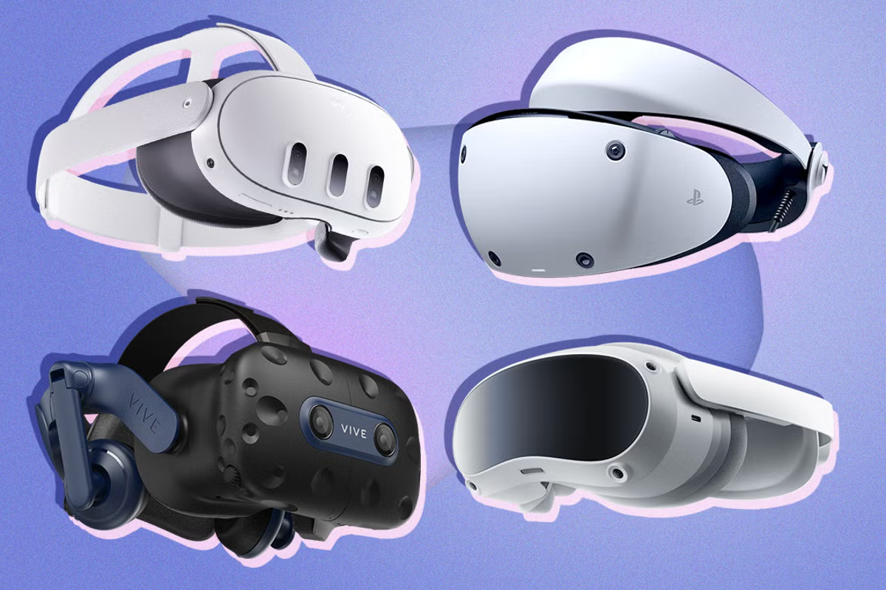
The Problem with Current Control
1.2
RECENT INNOVATION
Altered reality
NFC
Motion control
Specialist control
Notes:
When answering this question, think about the specific challenge or gap in your field of study that your project aims to address.
Problem Solving: Think about the impact of your solution: e.g. how will addressing this problem improve the game or the player's experience? Your goal is to clearly define the problem so that your project has a clear direction and purpose
What are the challenges that are associated with the project? Do you need to retain a specific Artstyle throughout production?
Visuals reference and resources: Include images, sketches, prototypes, or other work-in-progress visuals, as well as resources that reaffirm your decision-making process such as videos, blogs, and tutorials
///////////////////////
Current Design Systems
Talk about how all games are played with either keyboard and mouse, gamepad or touchscreen, which mainly use buttons
Talk about how innovating in control can lend itself to a more interesting diverse game environment
Talk about nostalgia how we used to create new systems (Nintendo Wii, NFC, PS2)
Innovations
VR
AR
NFC
Motion Control
Specialist Controllers
Lack of Diversity
Games feeling same-y
Games being unable to break the norm
Immersion barriers
Expand the ability for people with disabilities to interact perhaps
Challenges
This isn’t a super documented field, as such could be tricky for resources
As its hardware and software based, pricing can be an issue
Using electronics poses safety risks
Outcome:
The goal of this project is to create a series of technical demos showcasing different input and output methods; and testing their feasibility in game development in hopes to expand the ways the player can interact with the game and hopefully how the game interacts with the player.

Slide 5
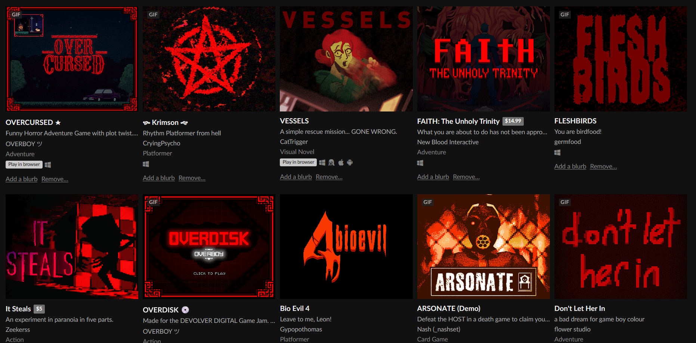
The Problem with Current Control
1.3
LACK OF DIVERSITY
Games feeling same-y
Breaking the norm
Immersion barriers
Disability Interaction
Notes:
When answering this question, think about the specific challenge or gap in your field of study that your project aims to address.
Problem Solving: Think about the impact of your solution: e.g. how will addressing this problem improve the game or the player's experience? Your goal is to clearly define the problem so that your project has a clear direction and purpose
What are the challenges that are associated with the project? Do you need to retain a specific Artstyle throughout production?
Visuals reference and resources: Include images, sketches, prototypes, or other work-in-progress visuals, as well as resources that reaffirm your decision-making process such as videos, blogs, and tutorials
///////////////////////
Current Design Systems
Talk about how all games are played with either keyboard and mouse, gamepad or touchscreen, which mainly use buttons
Talk about how innovating in control can lend itself to a more interesting diverse game environment
Talk about nostalgia how we used to create new systems (Nintendo Wii, NFC, PS2)
Innovations
VR
AR
NFC
Motion Control
Specialist Controllers
Lack of Diversity
Games feeling same-y
Games being unable to break the norm
Immersion barriers
Expand the ability for people with disabilities to interact perhaps
Challenges
This isn’t a super documented field, as such could be tricky for resources
As its hardware and software based, pricing can be an issue
Using electronics poses safety risks
Outcome:
The goal of this project is to create a series of technical demos showcasing different input and output methods; and testing their feasibility in game development in hopes to expand the ways the player can interact with the game and hopefully how the game interacts with the player.

Slide 6

The Problem with Current Control
1.4
CHALLENGES
Undocumented Field
Pricing
Safety
Notes:
When answering this question, think about the specific challenge or gap in your field of study that your project aims to address.
Problem Solving: Think about the impact of your solution: e.g. how will addressing this problem improve the game or the player's experience? Your goal is to clearly define the problem so that your project has a clear direction and purpose
What are the challenges that are associated with the project? Do you need to retain a specific Artstyle throughout production?
Visuals reference and resources: Include images, sketches, prototypes, or other work-in-progress visuals, as well as resources that reaffirm your decision-making process such as videos, blogs, and tutorials
///////////////////////
Current Design Systems
Talk about how all games are played with either keyboard and mouse, gamepad or touchscreen, which mainly use buttons
Talk about how innovating in control can lend itself to a more interesting diverse game environment
Talk about nostalgia how we used to create new systems (Nintendo Wii, NFC, PS2)
Innovations
VR
AR
NFC
Motion Control
Specialist Controllers
Lack of Diversity
Games feeling same-y
Games being unable to break the norm
Immersion barriers
Expand the ability for people with disabilities to interact perhaps
Challenges
This isn’t a super documented field, as such could be tricky for resources
As its hardware and software based, pricing can be an issue
Using electronics poses safety risks
Outcome:
The goal of this project is to create a series of technical demos showcasing different input and output methods; and testing their feasibility in game development in hopes to expand the ways the player can interact with the game and hopefully how the game interacts with the player.

Slide 7
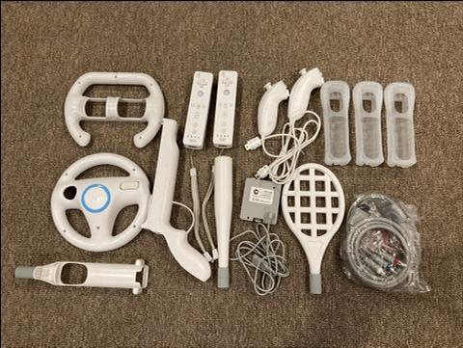
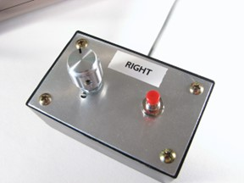
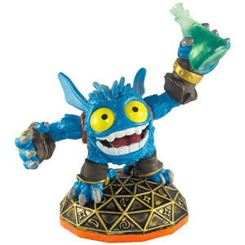

Key Influences
2.1
PRIOR CONTROLLERS
Nintendo Wii
VR
AR
NFC
Tennis For Two
Notes:
Highlight key influences from similar projects.
Visuals: Include images, screenshots, or logos of the projects or works that have influenced your idea
Analysis: A few bullet points explaining what you learned from these influences and how they relate to your project, as well as how specific aspects will be altered to better match the final deliverable of your project.
////////////////////////////
Prior Innovation in Control
PRIOR CONTROLLERS
Nintendo Wii
Rumble Packs in Controllers (PS1 was first but Nintendo is credited)
VR
AR NFC
Tennis For Two (one of the first games ever, it was played on an Oscilloscope)
IDEA FOR PROJECT
Experimental Games Design
Summer Project

Slide 8


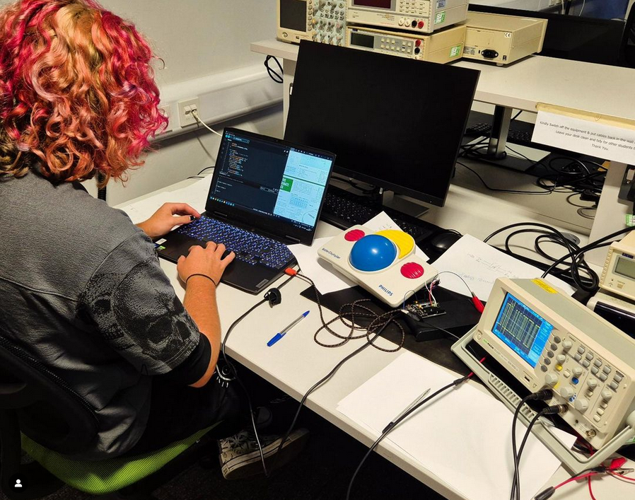
Key Influences
2.2
PREVIOUS DEVELOPMENT
Experimental Games Production
Summer Project
Notes:
Highlight key influences from similar projects.
Visuals: Include images, screenshots, or logos of the projects or works that have influenced your idea
Analysis: A few bullet points explaining what you learned from these influences and how they relate to your project, as well as how specific aspects will be altered to better match the final deliverable of your project.
////////////////////////////
Prior Innovation in Control
PRIOR CONTROLLERS
Nintendo Wii
Rumble Packs in Controllers (PS1 was first but Nintendo is credited)
VR
AR NFC
Tennis For Two (one of the first games ever, it was played on an Oscilloscope)
IDEA FOR PROJECT
Experimental Games Design
Summer Project

Slide 9


Research Plan
4.1
Looking at different types of available hardware
Figure out feasibility as a control system
Create a mind map of ideas
Test and peer review those ideas
If an idea is successful, create a prototype
Test it again
RESEARCH AND DEVELOPMENT LOOP
Notes:
What research are you going to do? Highlight if this project will introduce any new avenues of learning.
Describe the research methods, sources, and areas you will explore.
Potential Obstacles: Identify any potential limitations in your plan and think about how these might impact your project.
Mitigation Strategies: Discuss strategies for overcoming any of these potential hurdles.
////////////////////////////
Looking at different types of available hardware
Arduino reference library for said hardware
creating plans for how it could interact with a game
create a mind map of ideas
test and peer review
successful ideas, create a prototype
test it again
feedback loop
the aim is to have 3-5 technical prototypes for the project, all with unique input and output methods

Slide 10

Research Plan
4.2
Problem - Mitigation
POTENTIAL OBSTACLES & MITIGATION STRATEGIES
Lack of Available Information
Go Back To Basics
Pricing of Materials
Just Use Prototyping Materials
Electrical Safety
Consult Risk Assessment
Controller Doesn’t Test Well
Get Feedback and Improve
Interfacing with PC
Use Pre-Existing Interfacing Devices
Notes:
What research are you going to do? Highlight if this project will introduce any new avenues of learning.
Describe the research methods, sources, and areas you will explore.
Potential Obstacles: Identify any potential limitations in your plan and think about how these might impact your project.
Mitigation Strategies: Discuss strategies for overcoming any of these potential hurdles.
////////////////////////////
Looking at different types of available hardware
Arduino reference library for said hardware
creating plans for how it could interact with a game
create a mind map of ideas
test and peer review
successful ideas, create a prototype
test it again
feedback loop
the aim is to have 3-5 technical prototypes for the project, all with unique input and output methods

Slide 11

Examples of key Literature and Research
5
Theory
Circuitry
GDC
YouTube
Arduino.CC
Freenove Projects Tutorials
Reddit
Datasheets
Unreal Engine
Unreal Documentation
Reddit
YouTube
Relevant Plugin Git Pages
Notes:
Journals and Books
Staffordshire University Libraries
GDC
Ensure you logged off after you have finished
Username: staffs@gdcvault.com
Password: StaFFs25VA724# (Password is case sensitive)
Page: https://gdcvault.com
YOU MUST LOG OUT WHEN YOU HAVE FINISHED!
YouTube
YouTube
////////////////////
Arduino.cc
Freenove Projects Board Library

Slide 12

Deliverables and Project Planning
6
Must Have:
Variety of technical prototypes, with unique input and output methods
Evaluation comparing new and old controllers and their usability and enjoyment factor
Will Not Have:
Art considerations
Multiplayer support
Should Have:
Tech demos to go with the controllers that don’t have to be polished however get the point across for how to play the game
Easily swappable controllers, plug and play would be ideal
Interfacing that means the controllers are not necessary for a game
Main Deliverable:
A project consisting of a few small tech demos, with accompanying experimental control systems.
Could Have:
Polished games
Available libraries and plans to create the controllers i make
Mock-up for a selling plan
Marketing for GradEX
Notes:
What will be your deliverables? List the expected outcomes of your project.
How will you ensure good time management?
Milestones: List key milestones of the project
Gantt Chart: Include a simple Gantt chart or timeline to help visually represent your schedule.
Time Allocation: Explain how much time will be allocated to different phases of the project (research, development, experimentation etc.)
https://www.ted.com/talks/tim_urban_inside_the_mind_of_a_master_procrastinator?subtitle=en
/////////////////////////////
MoSCoW: MUST HAVE:
The aim is to have 3-5 technical prototypes for the project, all with unique input and output methods
An evaluation comparing my new technologies with old systems and comparing their usability and enjoyment rating
SHOULD HAVE: Accompanying games / tech demos to go with the controllers that don’t have to be polished however get the point across for how to play the game
easily swappable controllers, plug and play would be ideal
Interfacing that means the controllers are not necessary for a game
COULD HAVE:
Polished games available libraries and plans to create the controllers I make
Mock-up for a selling plan
Marketing for GradEX
WILL NOT HAVE:
Art considerations
Multiplayer Support

